Slide 1


Data Science Summit’21
Business Analysis Challenge
Team – Extra Miles

Slide 2
Team Members
Animesh Parikshya
E-Mail: animeshparikshya@yahoo.in
Phone: +91 9866500604
Dr. Anshika Sharma
E-Mail: anshi1986@rediffmail.com
Phone: 9760199007
Tanisha Jain
E-Mail: tanishajainn225@gmail.com
Phone: 8859976883
Arpit Dhawan
E-Mail:
Phone:

Slide 3
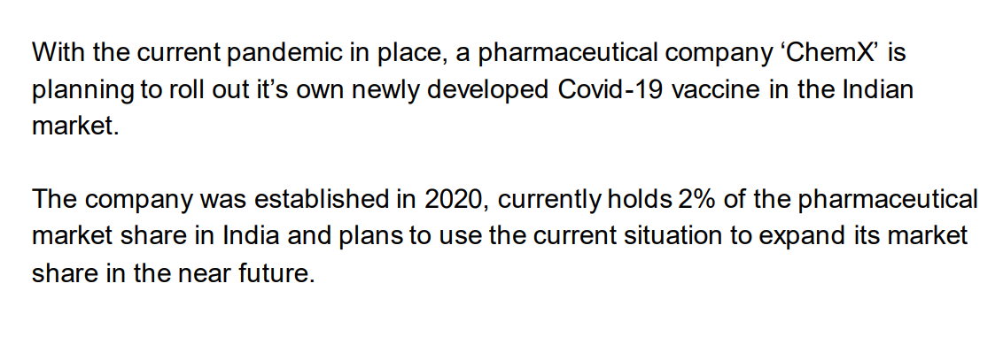
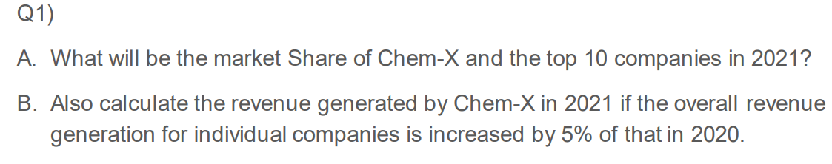
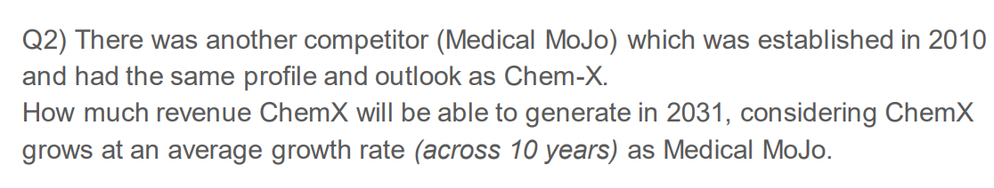
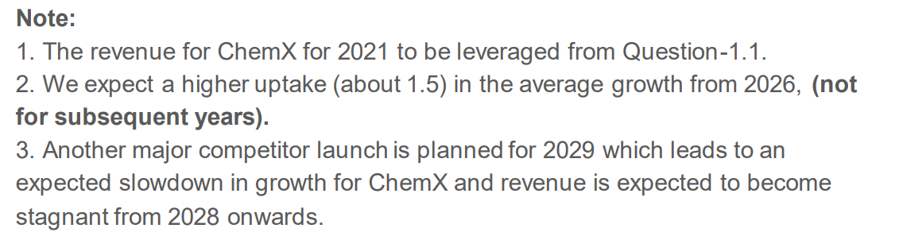
Problem Statement

Slide 4
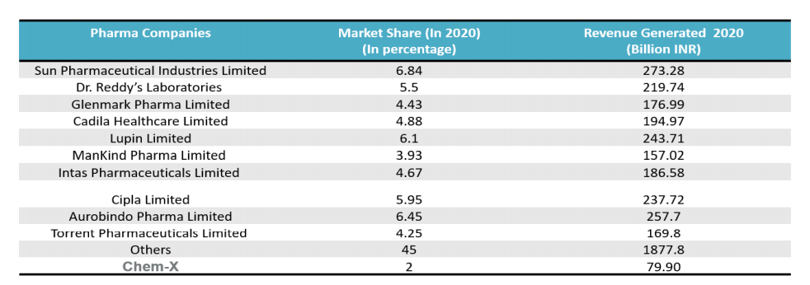
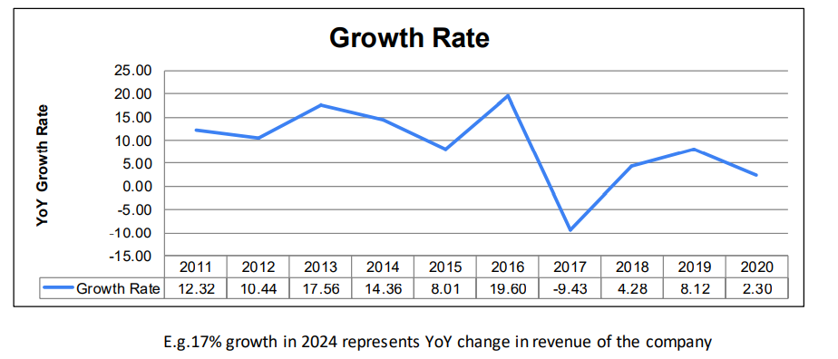
Data
Market Share of Pharma Industry
Click here for actual data csv →
Growth Trend of Medical Mojo
Click here for actual data csv →

Slide 5
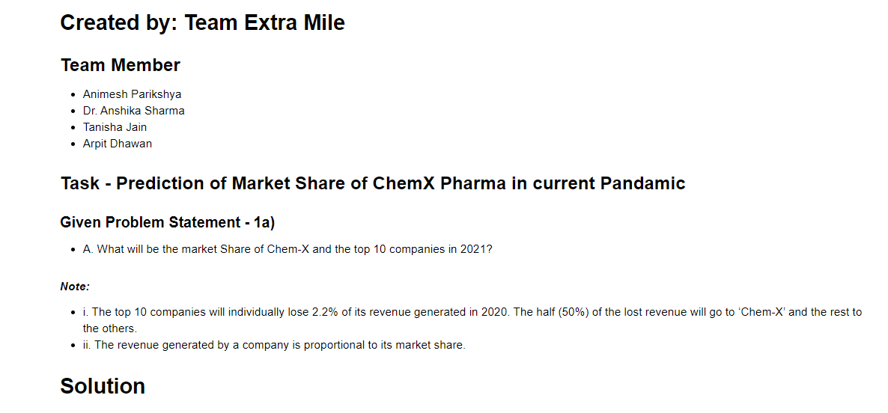
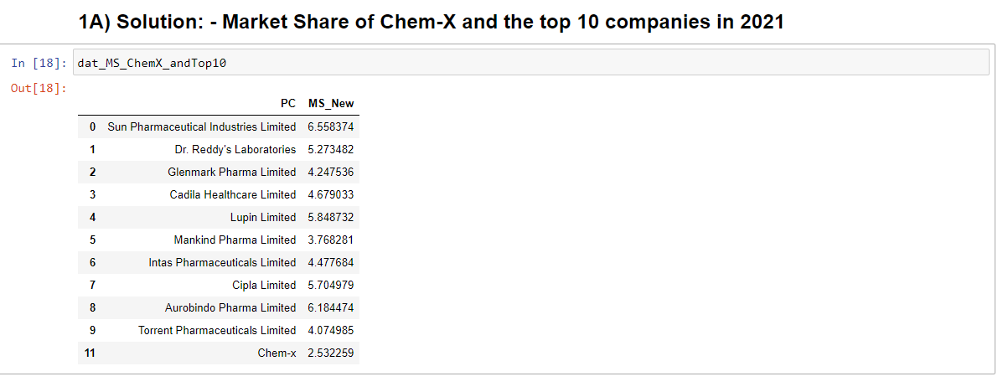
Solution

Slide 6
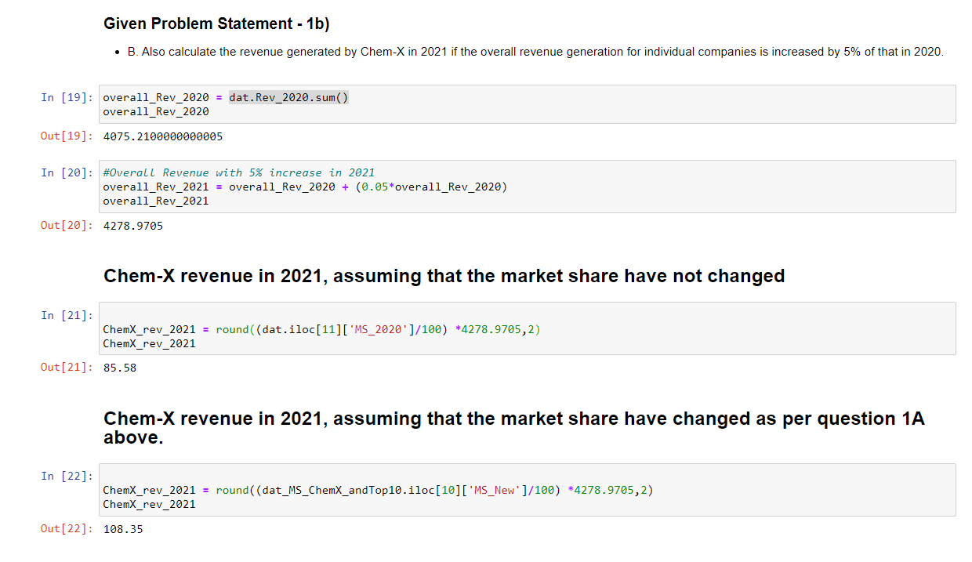
Solution

Slide 7
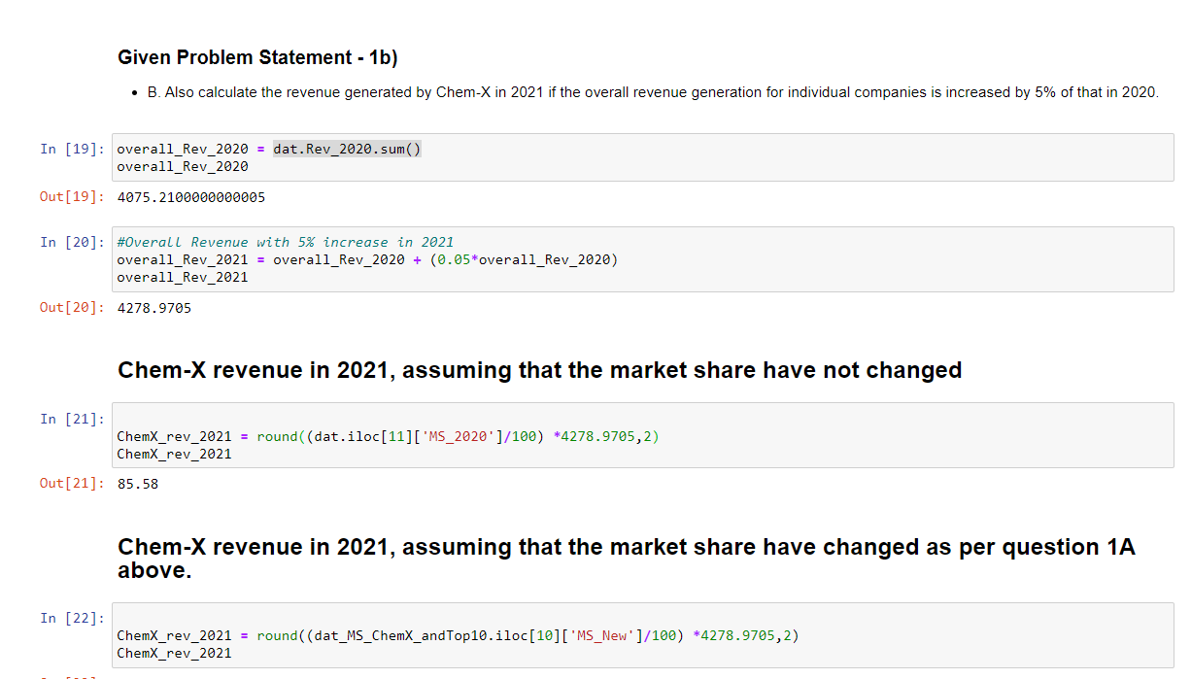
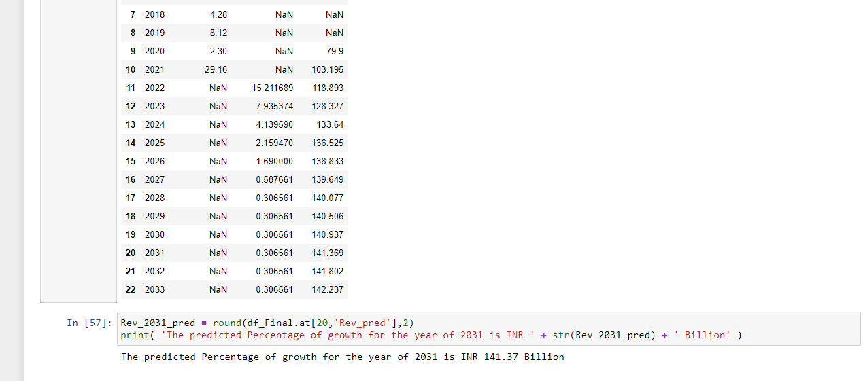

Solution
Full code in PDF format→
Full code in Jupyter notebook format→

Slide 8
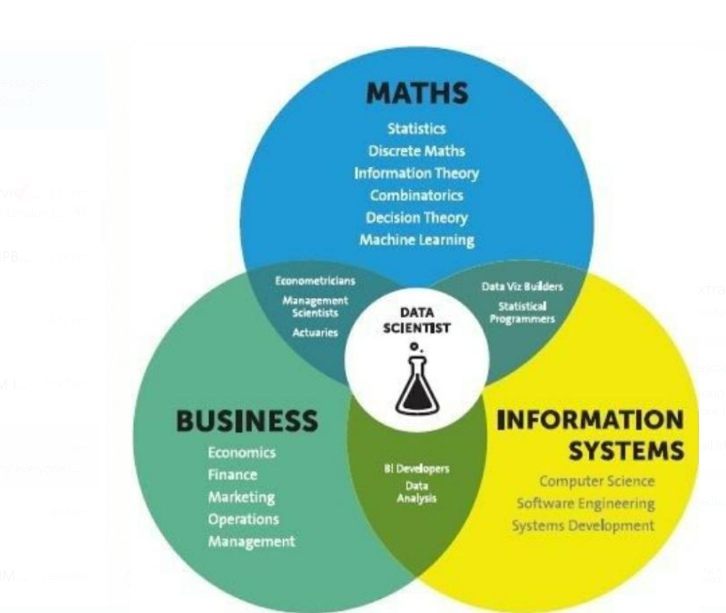
Thank You

